Slide 1
COMP 4442: Final Project Presentation
Applying Extreme Value Theory
to Tesla stock data
Chia Han Lee & Darina Kamikazi

Slide 2
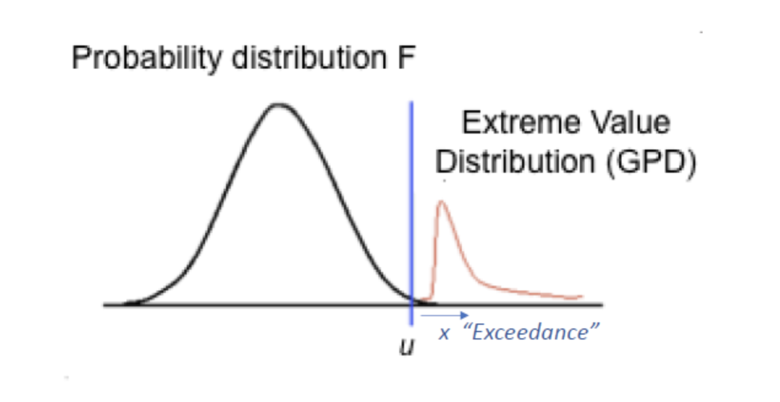
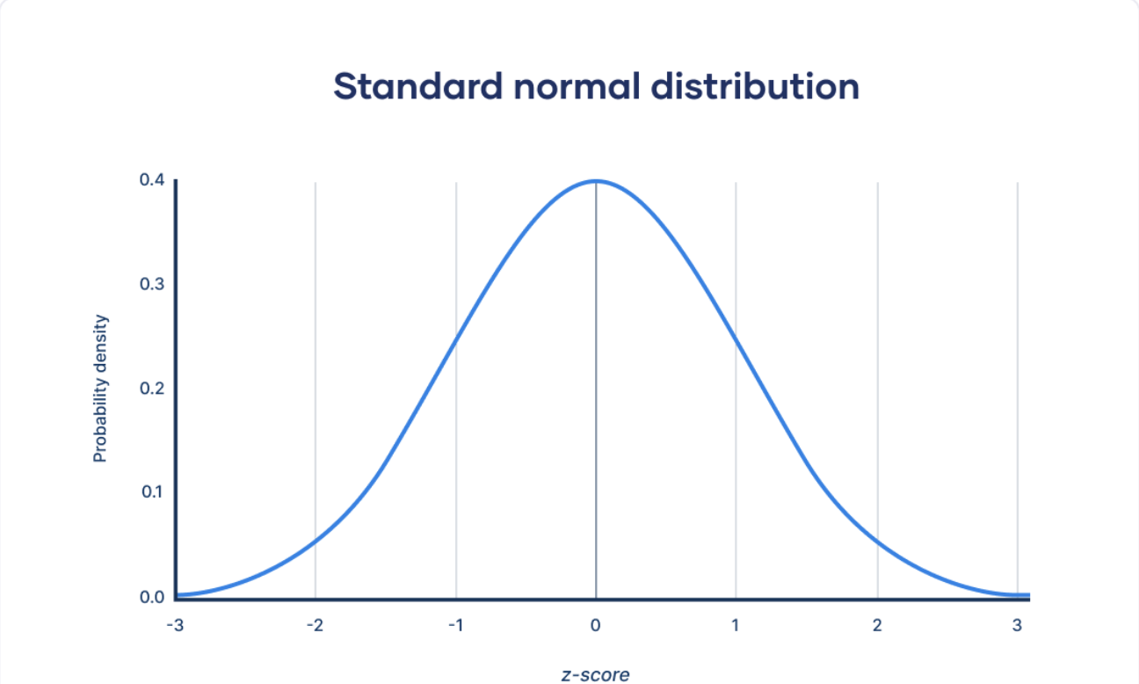
Extreme event occurrence
EVT Distributions
Normal Distributions
Issues with Normal distributions
Assumptions:
iid samples
Continuous, univariate data

Slide 3
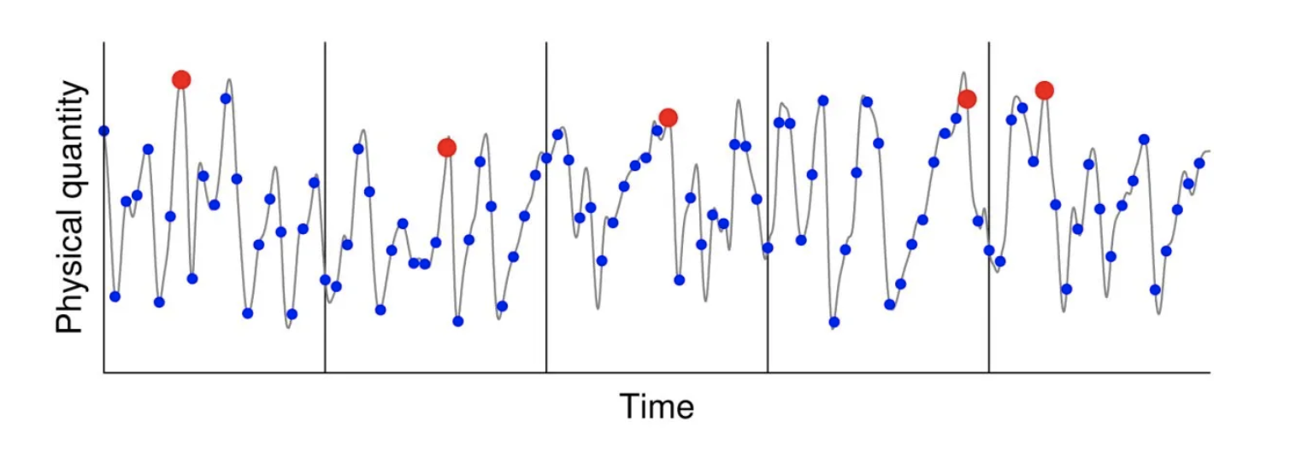
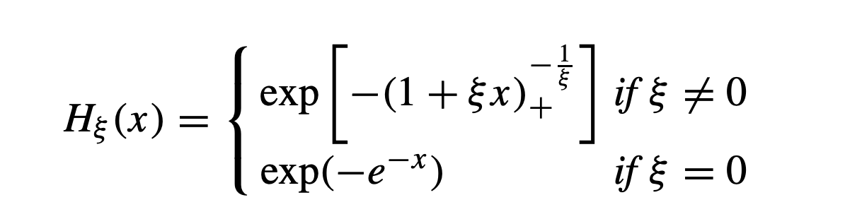
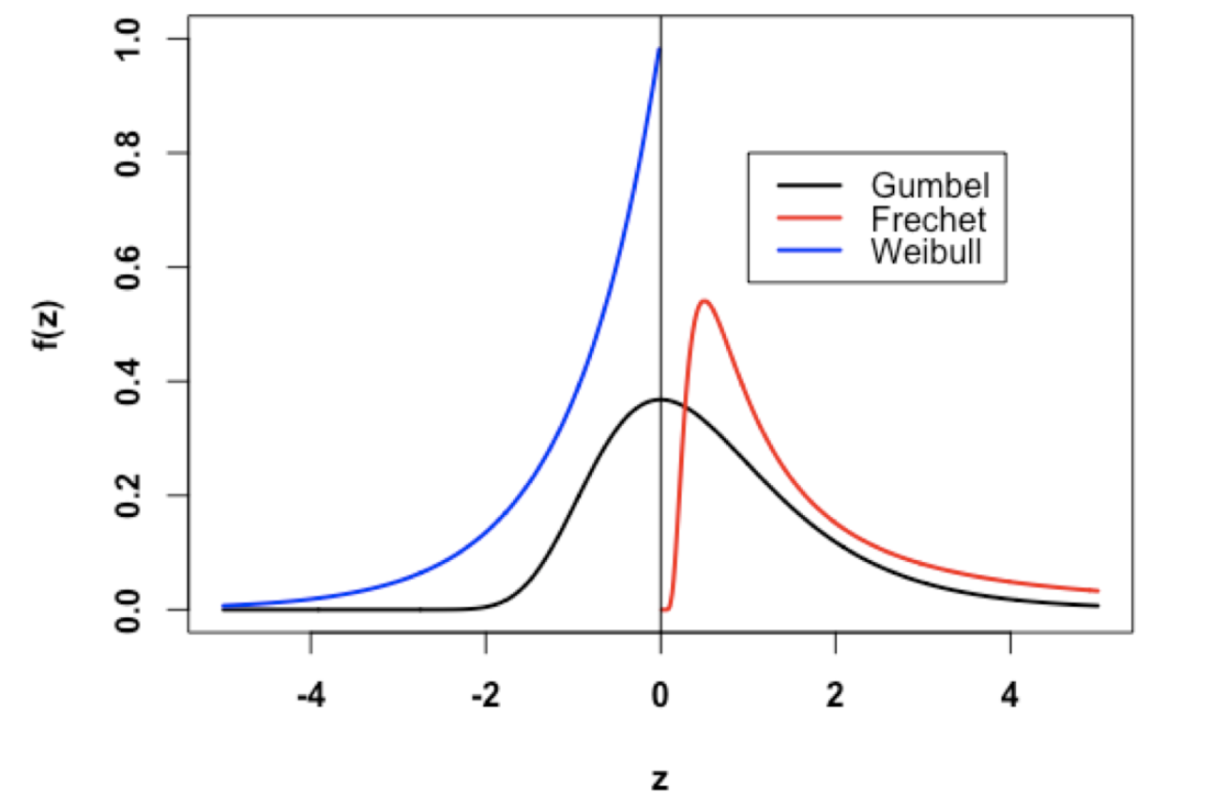
Block Maxima
Extreme Value Theory (EVT)
EVT vs CLT
2 Methods:
Block Maxima Method
Peaks Over Threshold (POT) Method
Block Maxima
Relies on a Generalized Extreme value Distribution(GED)
Uses Maximum negative log return
GED
Frechet-Fisher-Tippett Theorem:
ξ < 0 , Weibull df (short-tailed, bounded)
ξ = 0 , Gumbel df (light-tailed)
ξ > 0 , Frechet df (heavy-tailed)
Frechet-Fisher-Tippett Theorem

Slide 4
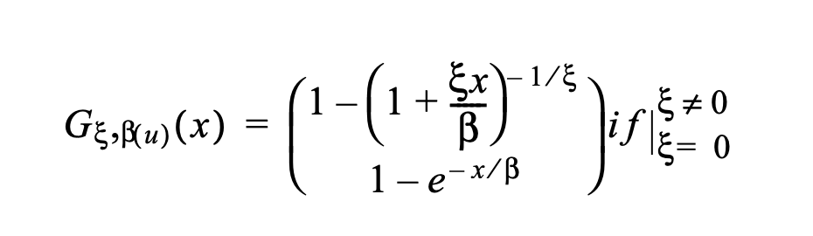
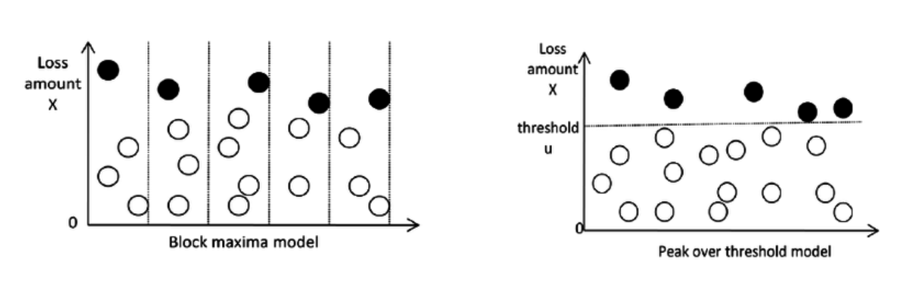
Peak Over Threshold (POT) Method
More commonly used
Advantage over BMM
ξ = shape
µ = location
θ = scale
Other important concepts:
Value-at-Risk (VaR)
Conditional Value-at-Risk (CVaR)
Hill’s Method
Relies on the Generalized Pareto Distribution(GPD)

Slide 5
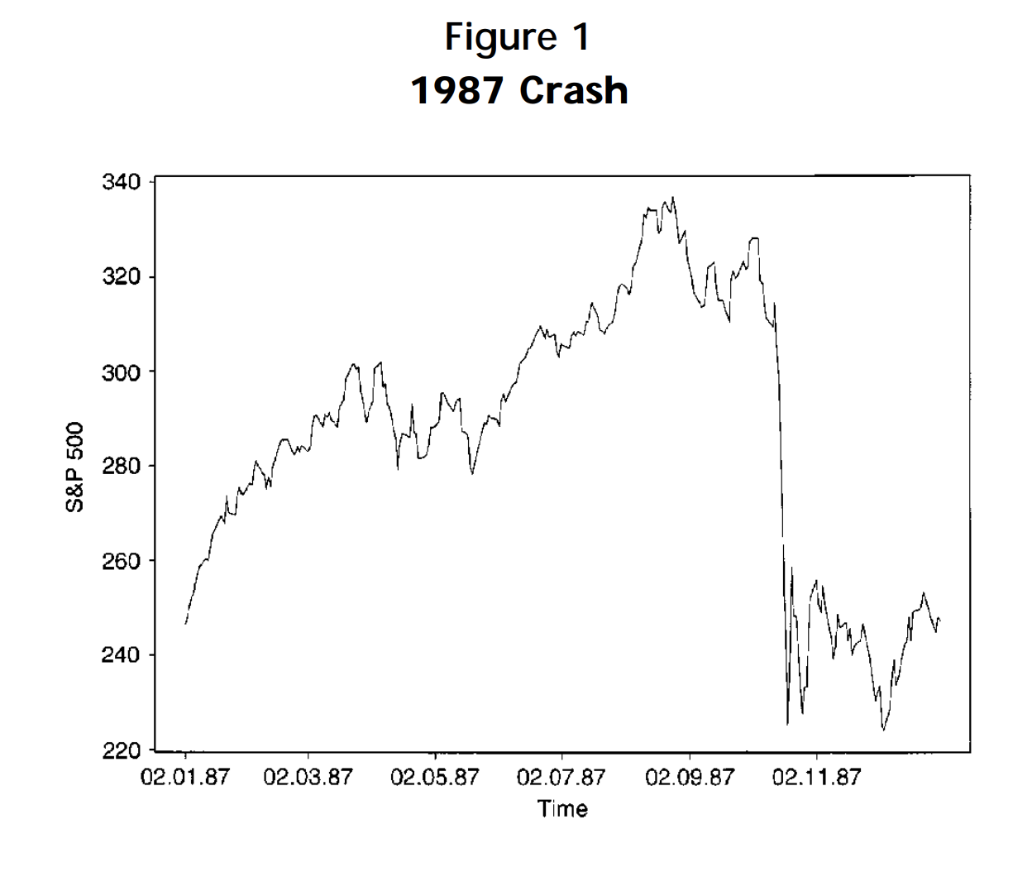


Application of EVT across Industries
Natural Sciences:
Human Lifespan
Natural Disaster Prediction
Finance: Risk Management
Sports: Record-breaking predictions

Slide 6

01
Research Question
”How can we use EVT to understand Tesla stock performance?"
Our
02
Tesla, Inc
Project
American multinational automotive and clean energy company
Traded on NASDAQ as TSLA
Founded in 2003
Revenue in 2022: 81.46 Billion USD
Notes:
So our research question is How can we use Extreme value theory to understand Tesla stock performance. Why we are choosing Tesla is because we think that electric vehicles will dominate the vehicle market in 15 years. Since Tesla is the biggest EV manufacturer but the price of tesla vehicles is declining recently, that’s the reason why we are finding the performance on Tesla stocks.

Slide 7
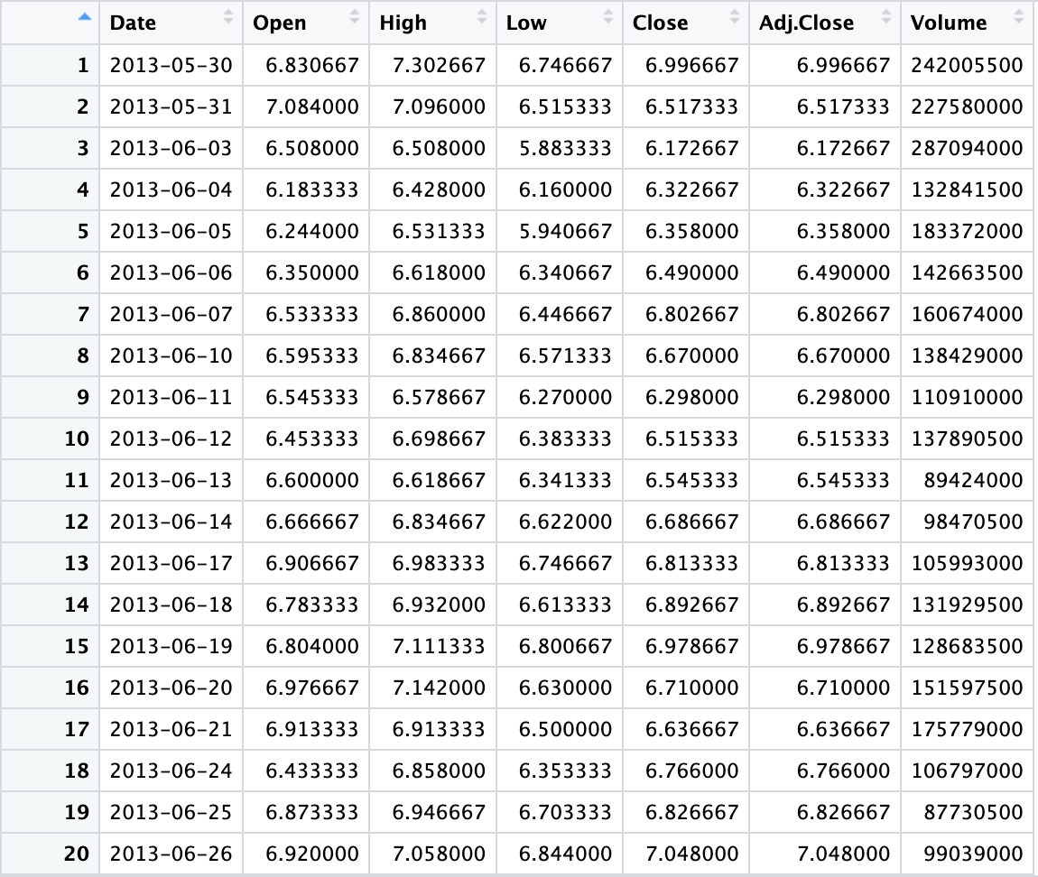
Data
Set
2517 observations for the 10-year period of 05/30/2013 - 05/26/2023
Obtained on Yahoo Finance
Variable of interest: Adjusted Close Values
Notes:
This is our data set which obtained on Yahoo Finance. We’ve got 2517 observations since May 30th 2013 to May 26th 2023. We got dates, Open and close price, highest and lowest price and volume. But we’re focusing our variable on Adjusted close values.

Slide 8
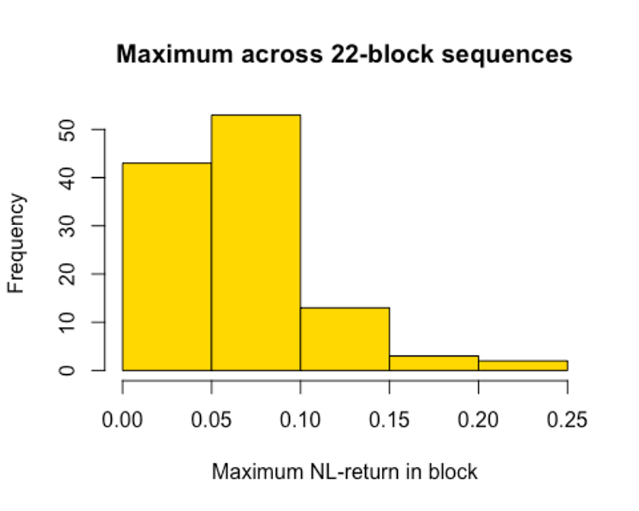
Frequency of Maximum
Negative Log Return
n = 22
log returns were calculated as:
ΔX_{i} = ln (S_{i}/S_{i+1})
Fitting to GED
μ = 0.04832916
θ = 0.02608783
ξ = 0.146346
Notes:
The graph is about the frequency of maximum negative log return. Log returns are logarithmic difference between the price of an asset at two different times. And here we use the negative log return. So one of the advantage of log return is that they are symmetric around zero. That is, positive and negative log returns are equally far from zero on a logarithmic scale. After fitting the GED, we can get the mu, theta and xi.

Slide 9
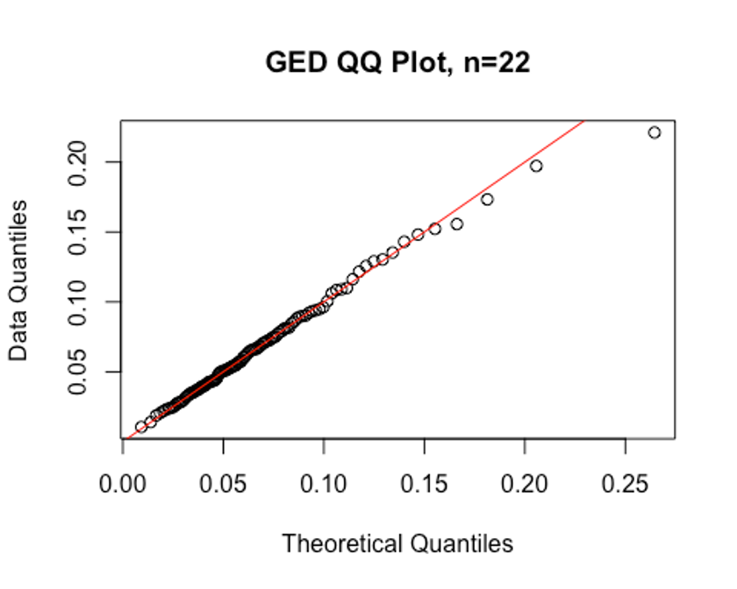
GED
QQ-Plot
We can see from the plot that the GED quite a good fit when n=22
Notes:
This is the GED QQ-plot. We can see that there are no outliers, so it seems a good fit when n equals to 22.

Slide 10
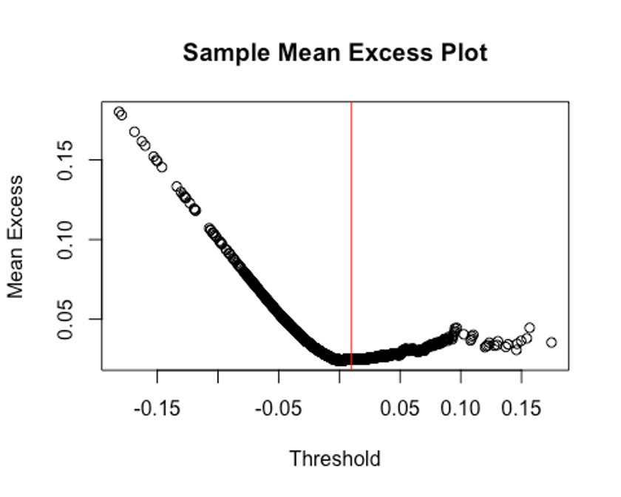
Threshold Exceedance Based Method
Fitting the Generalized Pareto Distribution (GPD)
Chosen μ = 0.01
θ = 0.02320922
ξ = 0.06970571
Notes:
This is the plot that where we can find the mu to fit in a GPD later. After fitting the GPD, we can get the value of theta and xi.

Slide 11
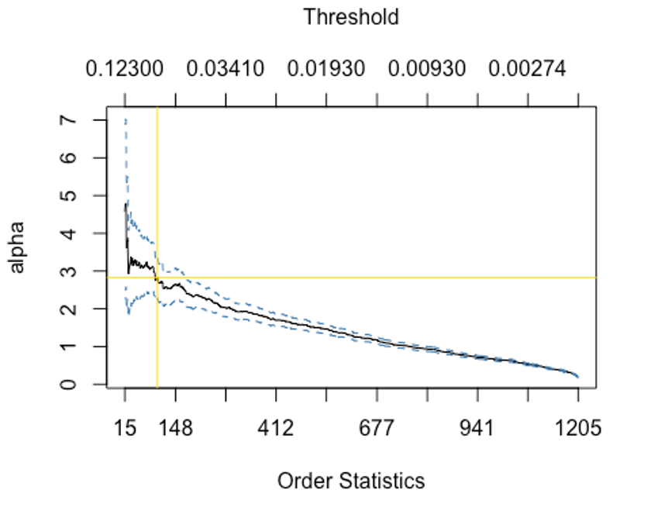
Hill
Plot
K = 100
Hill Estimator = 2.824095
Notes:
We can see from the hill plot that the k is about 100 and the hill estimator is 2.824. That’s the value what we can prepare for the next analysis.

Slide 12
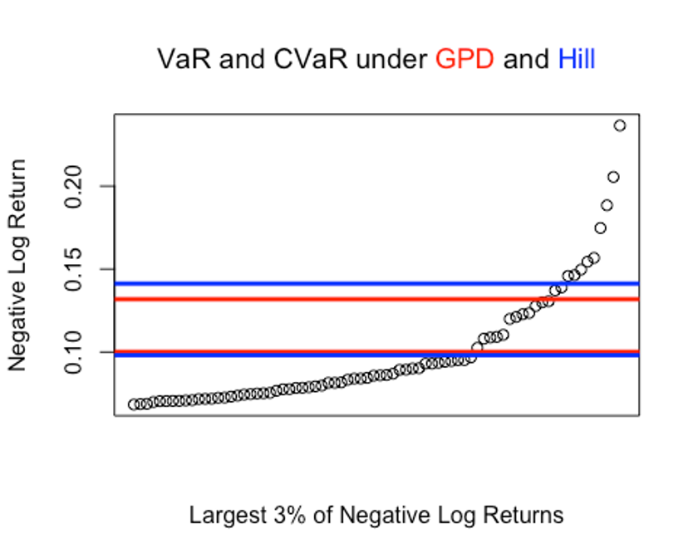
GPD
VaR_{0.99} = 0.100125
CVaR_{0.99} = 0.1318262
VaR & CVaR Under GPD & Hill
Hill’s Method
VaR_{0.99} = 0.0981399
CVaR_{0.99} = 0.1412526
Notes:
We can get the var and cvar value of the GPD and the Hill’s Method. And the graph is to compare the two. We can see that the results of the two methods are quite close. So we can choose either one for the analysis.

Slide 13
Benefits of EVT
Disadvantages of EVT
EVT Concepts not covered by our research
Multivariate EVT
Non-stationary EVT
Conclusion

Slide 14

THANK
You

